Slide 1



Planning a Park in the City
Mercy College
Borough of Manhattan Community College
STEM CAMP - Summer 2015
Kaitlin Brennan, Darianny Brito, Toni Pellegrino,
Fredy Reyes Vigil, Armani Willis

Slide 2
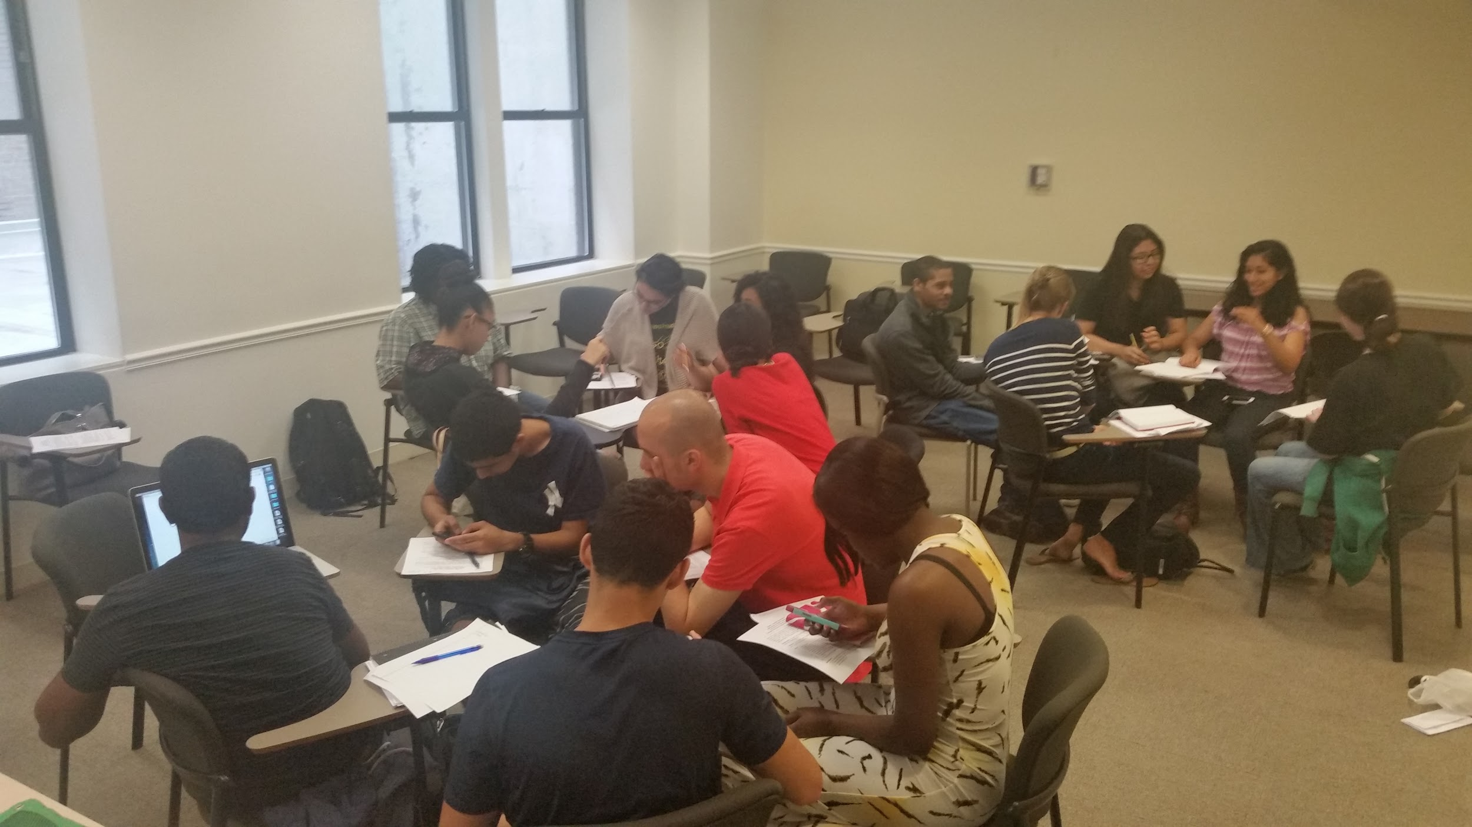
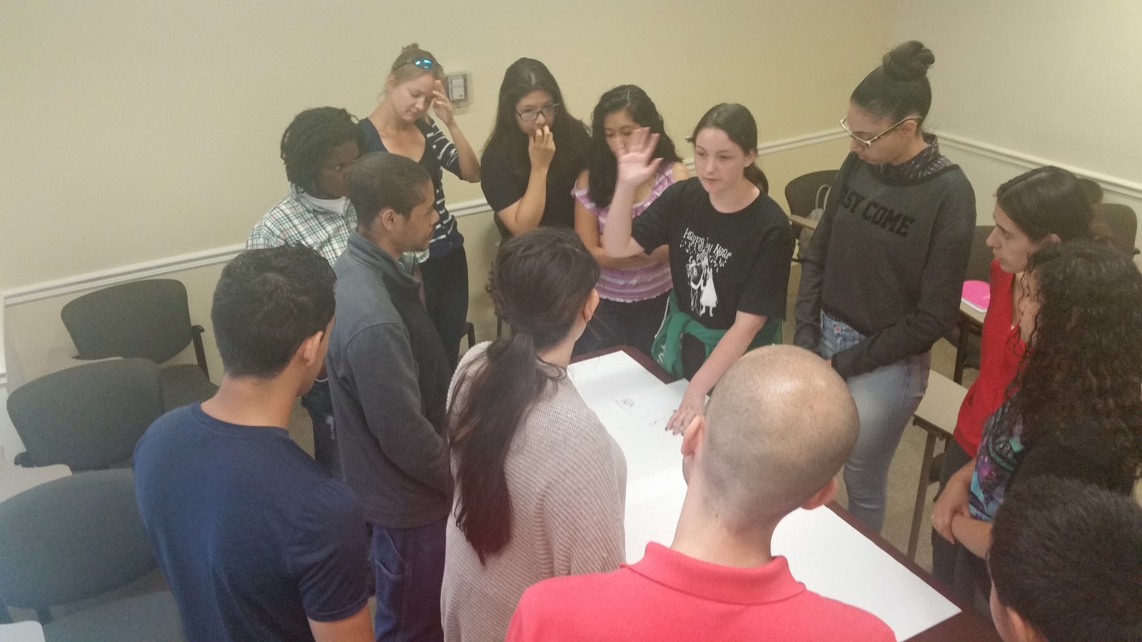
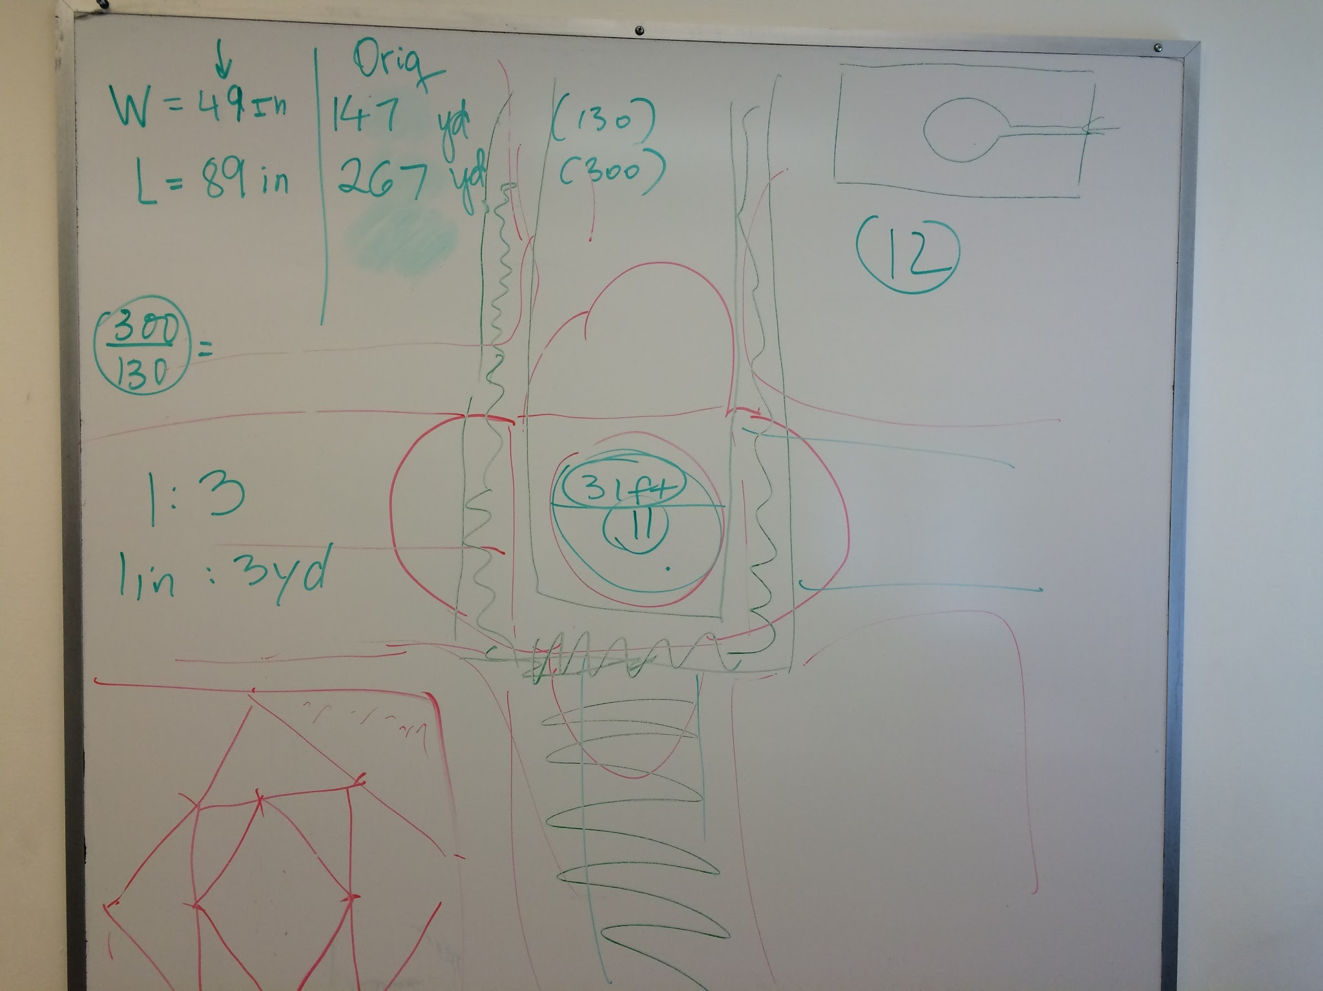
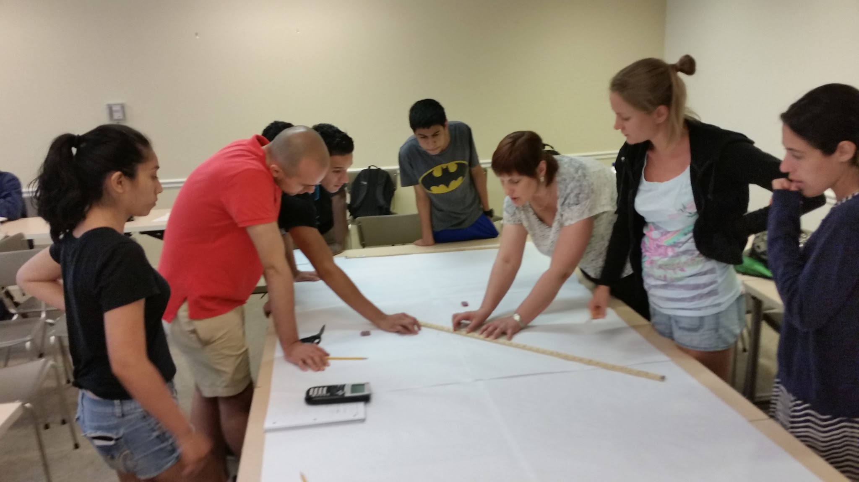
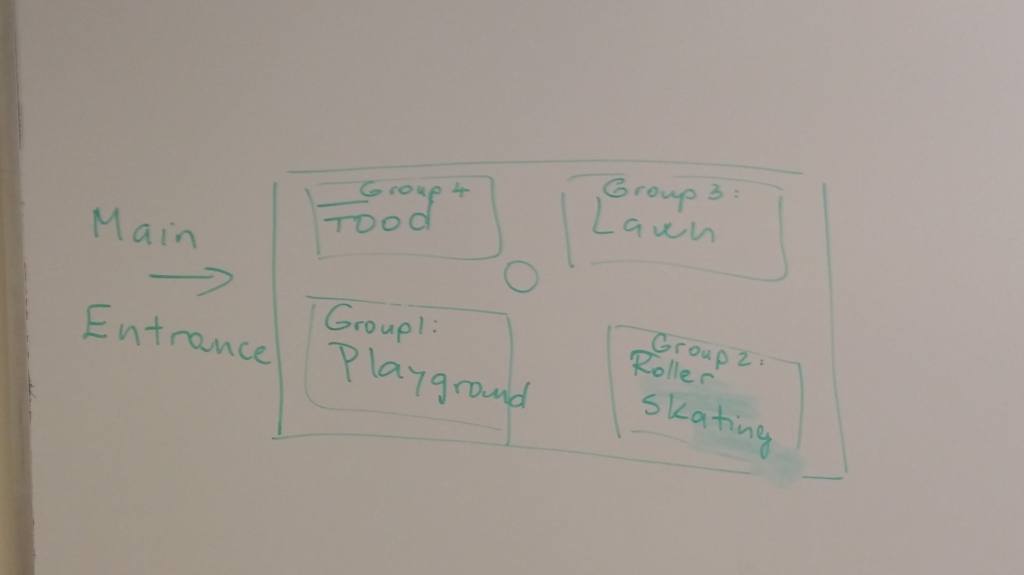
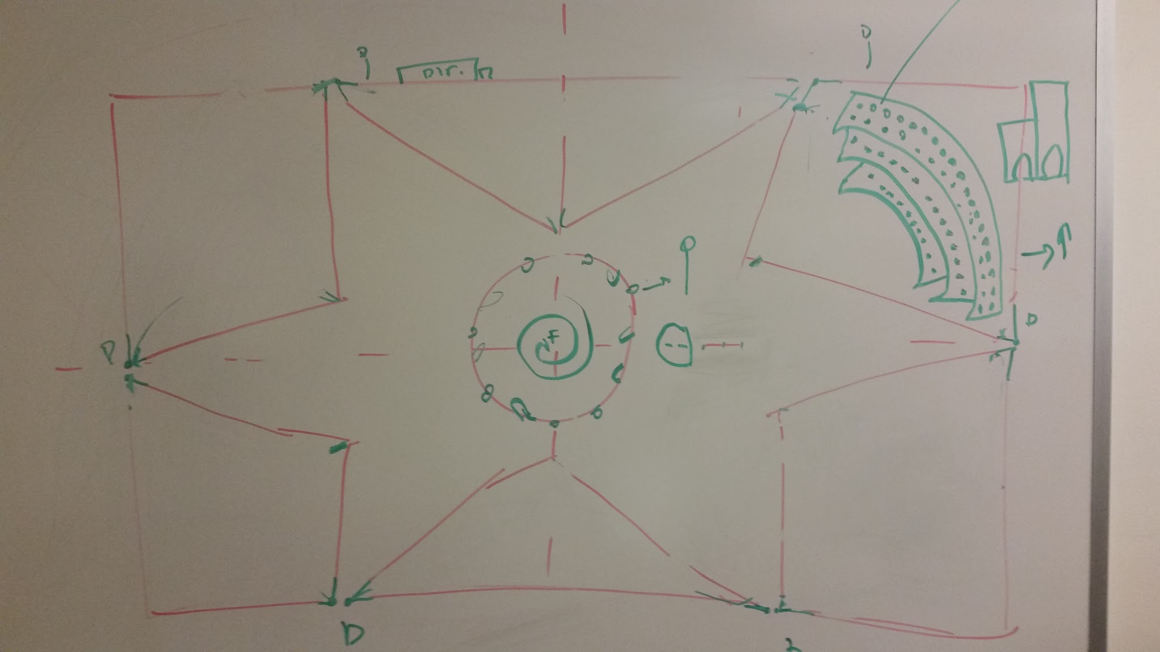
Background Information
Brainstorming
Notes:
-we got together as a group and started with the ideas.
-we compared ideas and brought them together.
we made different draft to come up with the park that we actually liked.

Slide 3
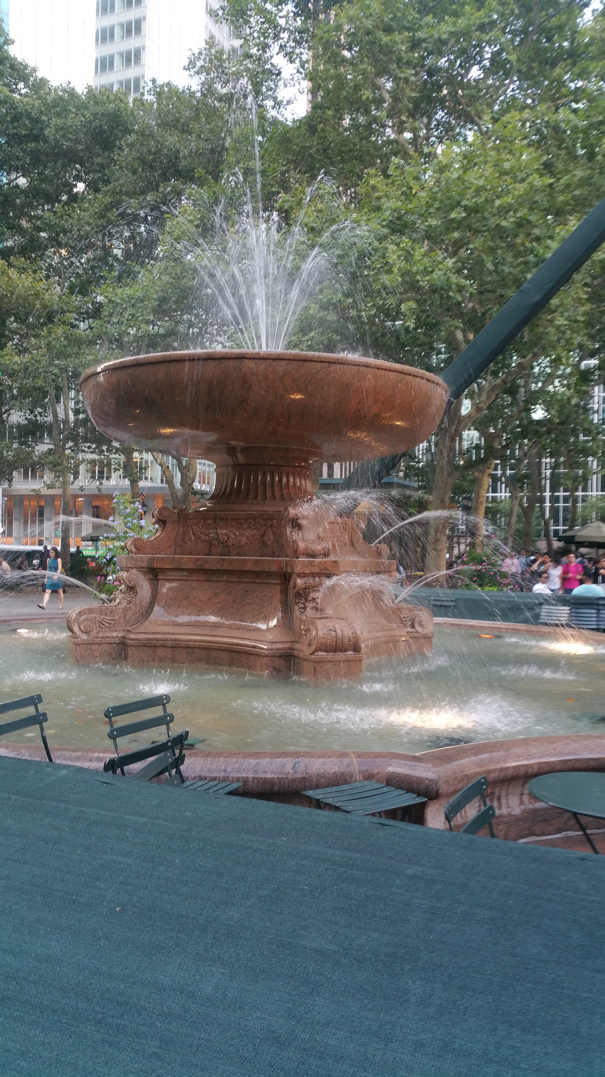
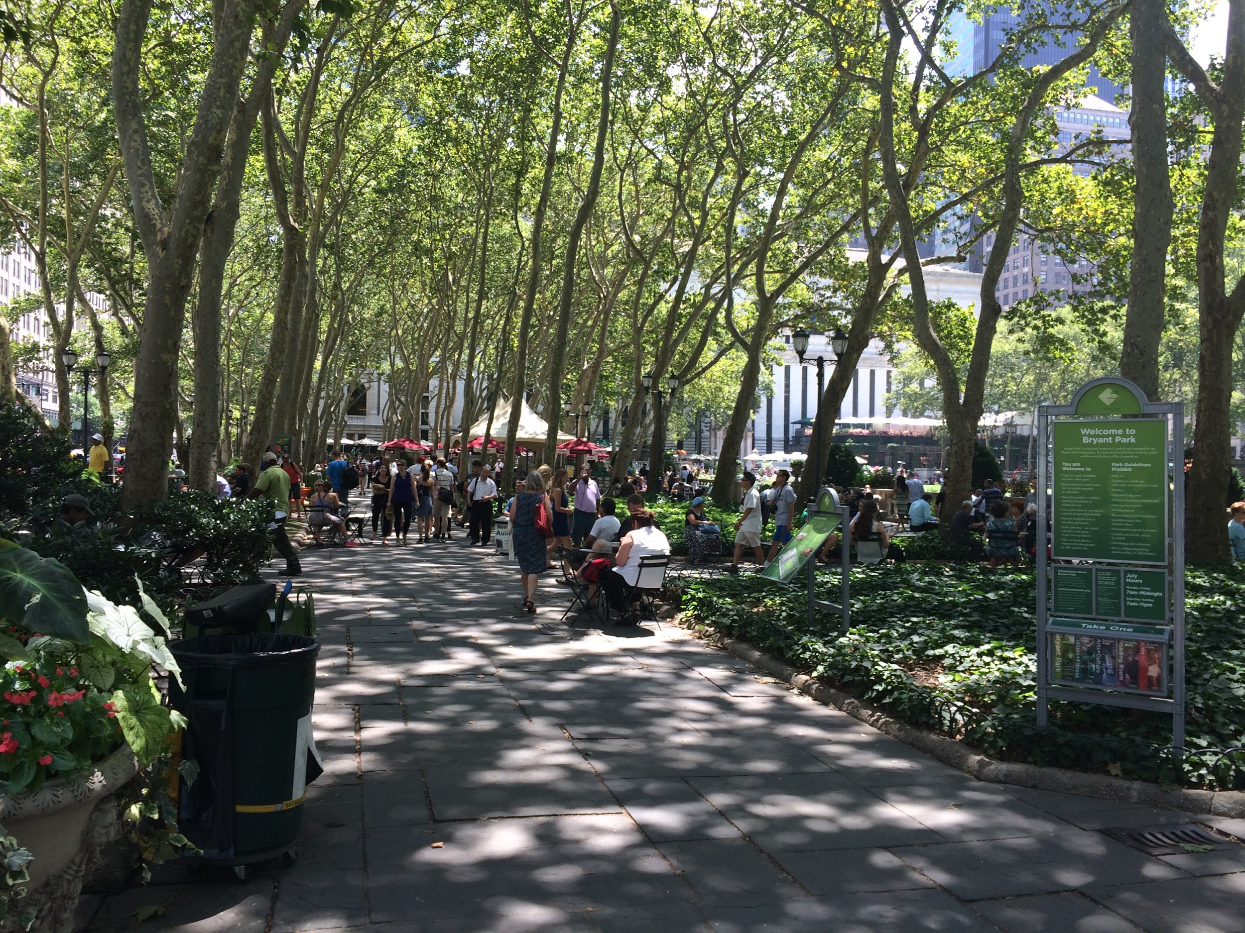
Background Information
Went to Bryant Park
measurements
pictures
gain knowledge
Notes:
we separated in four groups of four.
we went to Bryant Park and measured the whole park by counting our steps from one extent to another.
by doing this things we would get an idea and feeling on how big our park would be and what it needed.

Slide 4
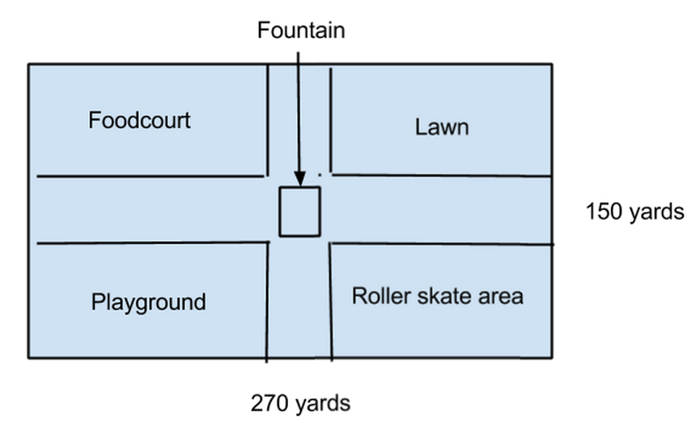
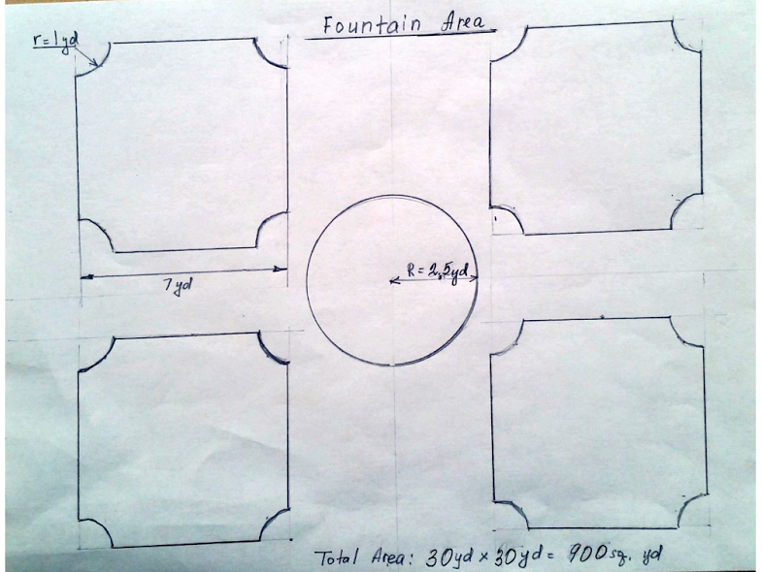
Planning the Park
Area of the park:40,500 sq yd
Perimeter of the park: 840 yards

Slide 5
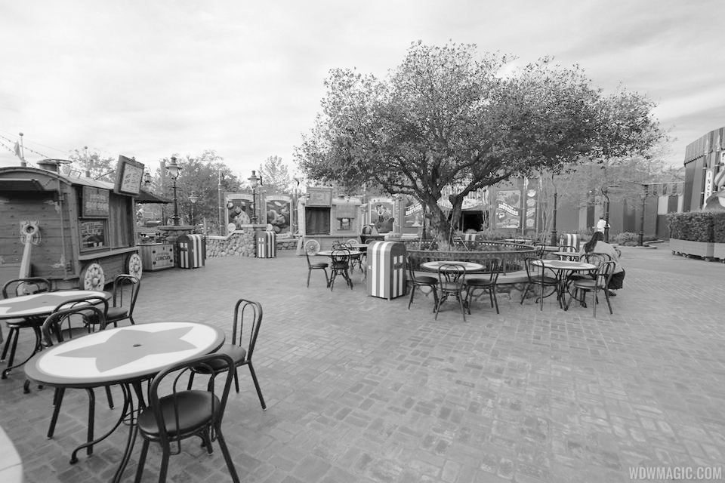
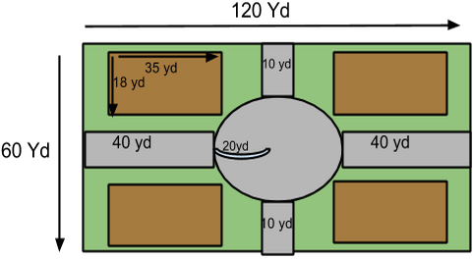
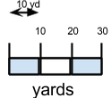
Food Area

Slide 6
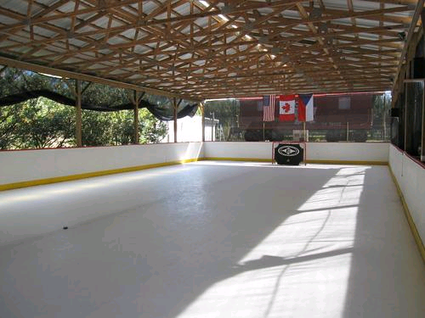
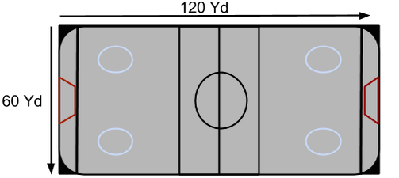
Rolling skate

Slide 7
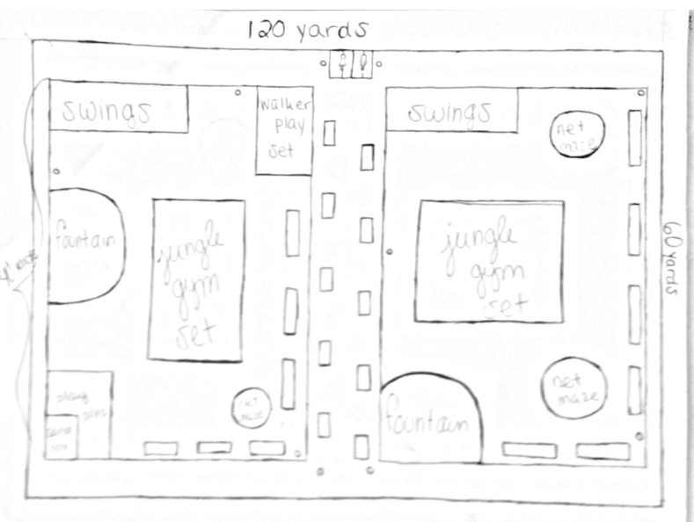
Playground

Slide 8
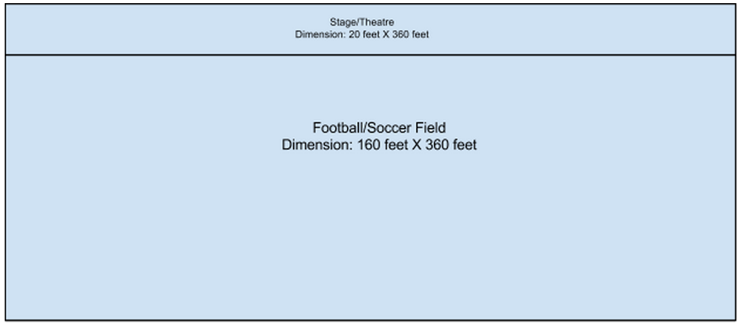

Lawn/Theater Area

Slide 9
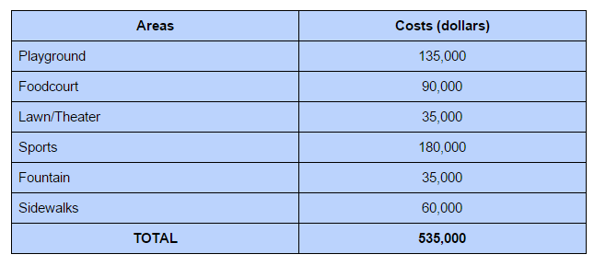
Total Costs of Materials

Slide 10
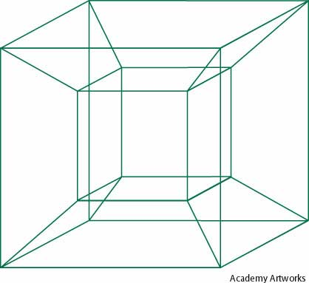

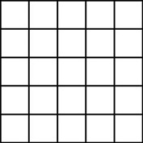
What We Learned
Dimensional Analysis (Conversion of Linear, Square, and Cubic Units).
Calculating Areas, Perimeters, Volumes of Complex Shapes.
Calculating the total volume of materials
needed.

Slide 11
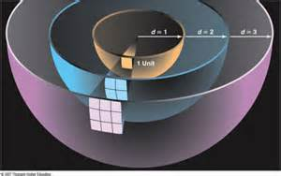
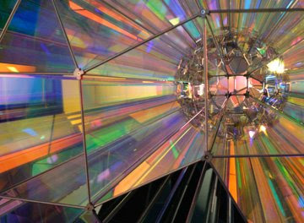
What We Learned
For Instance: Calculating the cost of Cement for the Skating Rink
We needed 7200 square yards, or 64,800 square feet by .5 feet, or 32,400 cubic feet of cement.
One 80 pound bag costs $3.17 and covers .591 cubic feet of space.
32,400cuft./.591cuft. = 54,822.34 80lb bags of cement, costing $174,786.80 in total.
http://www.lowes.com/ProductDisplay?partNumber=10385-286-110180&langId=-1&storeId
=10151&productId=3006075&catalogId=10051&cmRelshp=rel&rel=nofollow&cId=PDIO1

Slide 12
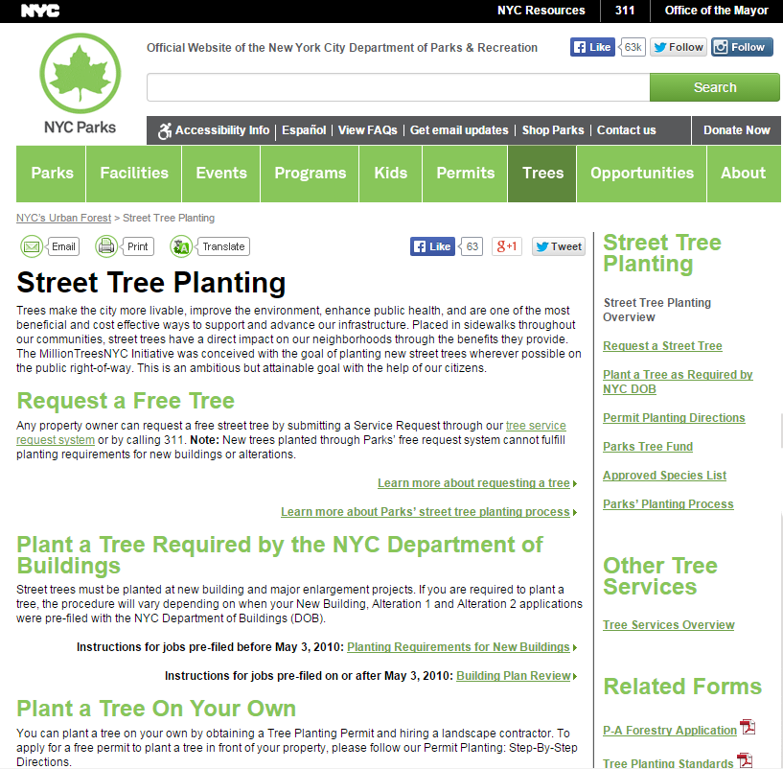
Findings Overall
Getting quotes
Portahead 25
It’s not cheap to swing
Trees, the law, and you
Permits and requirements in NYC
General insurance and liability
Notes:
http://www.nycgovparks.org/trees/street-tree-planting

Slide 13
Limitations
Labor cost
Water bill and source
Electric bill
Maintenance
General time constraint

Slide 14
Conclusion
Being such a densely populated area, Manhattan is in need of more parks. A lot of math goes into planning a sustainable park for all ages. Keep in mind, we only calculated how much it would take to open the park. We hope to add on to this project in the future!

Slide 15
Sources
http://www.gametime.com
http://www.ssww.com/item/super-dome-permanent-playground-climber-W7771/
http://www.portablehandwashing.com/PolyJohn-PJN3-Portable-Restroom-PJN3-1000-p/pjn3-1000.htm?CAWELAID=120205770000000689&CAGPSPN=pla&catargetid=120205770000000834&cadevice=c&gclid=CIGP6OCG_sYCFQsRHwodih8MLQ
http://www.bciburke.com/fsstoneborders.html
http://www.homedepot.com/p/Unbranded-50-lb-All-Purpose-Play-Sand-55141/100577543
http://www.homewyse.com/costs/cost_of_rubber_flooring.html
http://www.drinkingfountaindoctor.com/halsey-taylor-4400-outdoor-drinking-fountain?utm_source=googlebase&utm_medium=cse&utm_campaign=base&gclid=CM_h566N78YCFcERHwod6CQIRw
http://www.globalindustrial.com/p/outdoor-grounds-maintenance/Benches-Picnic-Tables/Benches-Wood/carolina-park-bench?infoParam.campaignId=T9F&gclid=CMWA7cGO78YCFY-HaQod8SIEwQ
https://www.schooloutfitters.com/catalog/product_info/pfam_id/PFAM30924/products_id/PRO42539
http://www.amazon.com/Melnor-4200M-Oscillating-Sprinkler-Control/dp/B0017QDHYM/ref=pd_sim_86_1/180-4923017-8216836?ie=UTF8&refRID=0CJ4PDEJ927B1K549PTQ
http://carvedstonecreations.com/index.php?route=checkout/cart
http://www.uline.com/Product/Detail/H-2999/Outdoor-Furniture/A-Frame-Wooden-Picnic-Table-6?pricode=WY699&gadtype=pla&id=H-2999&gclid=Cj0KEQjwrdetBRCJg92s44SB77IBEiQAEIWmVf508M3b0lPhkZdQQHQWqxSxPNxv3pentGlDOrAdzxoaAo5H8P8HAQ&gclsrc=aw.ds

Slide 16
Sources
http://www.lowes.com/ProductDisplay?partNumber=10385-286-110180&langId=-1&storeId=10151&productId=3006075&catalogId=10051&cmRelshp=rel&rel=nofollow&cId=PDIO1
https://shop.arborday.org/product.aspx?zpid=904
http://www.epromos.com/product/8825170/porta-potty-promotional-stress-ball.html?Promocode=QDBAAE1201&pi_ad_id=48198701526&Source=Google&kw=&_vsrefdom=pla&kpid=8825170&kpid=8825170&gclid=Cj0KEQjwrdetBRCJg92s44SB77IBEiQAEIWmVWILf6ykVb6SVY7LbXbHmgOrSEVAMXfetTbzQLCPfiUaAjcB8P8HAQ
http://www.homedepot.com/p/Unbranded-Real-Wood-26-in-dia-Cedar-Half-Whiskey-Barrel-Planter-G3056/204661482
http://www.tci.tdcj.texas.gov/products/metal/park/trashcansanantonio.aspx
http://www.ebay.com/itm/400-Watt-Metal-Haide-Outdoor-Parking-Lot-Light-Fixture-with-6-Mounting-Arm-/381266086601
http://www.globalindustrial.com/p/janitorial-maintenance/floor-care/cleaners/global-174-floor-machine-1-5-hp-20in-deck-size?infoParam.campaignId=T9F&gclid=CjwKEAjw0NytBRD-1d3QsdHNpR0SJACGXqgR9EhLDD7UKyoaXP0auvWX7OnOsvle_pqvgQy7ILXQOBoC5irw_wcB
https://www.landscaperoutlet.com/Four-Seasons-Fountain--3-Tier-W/12-Pond
http://www.nycgovparks.org/trees/street-tree-planting

